Slide 1

Capstone Project1
MANUFACTURING EQUIPMENT OUTPUT PREDICTION WITH LINEAR REGRESSION
Team Members
T120100204: DINESH S
T120100205: SRUJAN S D
T120100206: SUDARSHAN
T120100207: DINESH G

Slide 2
Table of Contents
Problem Statement
Overview of the Project
Data generation & Loading
Data Exploration & Understanding
Exploratory Data Analysis
Data Preprocessing & Feature Engineering
Model Building & Training
Model Evaluation & Performance Analysis
Stream API Deployment
Docker Deployment
Conclusion

Slide 3
Problem Statement
The manufacturing company faces a challenge in optimizing production efficiency for its injection molding machines. Currently, there is a gap as no reliable method exists to predict the hourly output (parts per hour) based on varying machine settings and operating conditions . This lack of predictability significantly impacts operations, leading to inefficient scheduling, difficulties in production planning, and a reduced ability to quickly identify and address underperforming machines. Therefore, our task is to address this problem by building and comparing predictive models capable of accurately forecasting hourly output.

Slide 4
Overview of the Project
Objective:
The goal of this project is to predict the equipment output rate (Parts Per Hour) using various production and process parameters collected from manufacturing systems. Accurate predictions help factory operators optimize resource usage, minimize machine downtime, and enhance overall equipment efficiency (OEE).
Approach:
Data was collected or generated to represent real-world manufacturing conditions.
Exploratory Data Analysis (EDA) was performed to understand feature relationships and detect patterns.
Features were preprocessed, normalized, and engineered for better model performance.
A Linear Regression model was trained to learn the relationship between input process parameters and the output (Parts Per Hour).
The model’s coefficients help in understanding how each feature influences output, providing valuable operational insights.
Finally, the model was deployed via a Fast API.

Slide 5
Data generation & Loading
Data Source: manufacturing_dataset_1000_samples.csv
Loading: The dataset was loaded into a pandas DataFrame.
Initial Inspection:
  Rows: 1,000
  Features: Injection_Temperature,
  Columns: 19 initially (Timestamp dropped later)
  Target Variable: Parts_Per_Hour
  Cycle_Time, Shift, Material_Grade, etc.

Slide 6
Data Exploration & Understanding
Data Types:
  Numeric (float/int): 13 features (e.g., Injection_Pressure, Machine_Age)
  Categorical (object): 4 features (Shift, Machine_Type, Material_Grade, Day_of_Week)
  Time/Other: 1 feature (Timestamp, dropped before training)
Missing Values: Checked using df.isnull().sum(). Found 20 missing values each in:
  Material_Viscosity
  Ambient_Temperature
  Operator_Experience
  Action: Handled using SimpleImputer during preprocessing.
Statistical Summary (df.describe()):
  Parts_Per_Hour (Target) ranges from 5.0 to 68.6, with a mean of 29.30.
  Features like Cycle_Time (mean: 35.85) and Material_Viscosity (mean: 251.63) show variation.

Slide 7
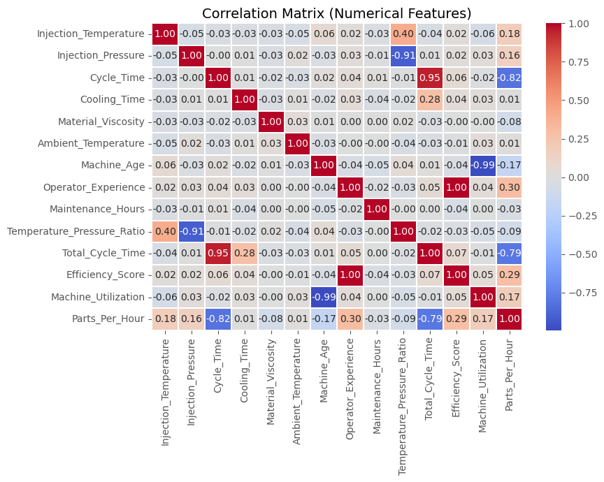
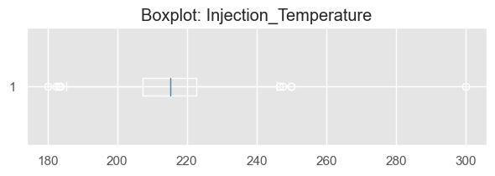
Exploratory Data Analysis
Visualized relationships between process parameters and output.
Analyzed feature distributions and outliers.
Used correlation heatmap for numeric feature relationships.

Slide 8
Data Preprocessing & Feature Engineering
Feature Selection:
  Target (y): Parts_Per_Hour
  Features (X): All columns except Parts_Per_Hour and Timestamp
Preprocessing Pipeline (ColumnTransformer):
  Numerical Features:
    Imputed missing values using SimpleImputer (median strategy).
    Scaled using StandardScaler.
  Categorical Features:
    Imputed missing values using SimpleImputer (constant strategy, fill='missing’).
    Encoded using OneHotEncoder.
Train-Test Split:
  Data split: 80% Training Set (800 samples), 20% Test Set (200 samples). random_state=42 used for reproducibility.

Slide 9
Model Building & Training
Model Choice: Standard LinearRegression from scikit-learn.
  Establishes a baseline performance.
  Interpretable coefficients.
Preprocessing Pipeline (preprocessor_std):
  Handles missing values (Imputation).
  Scales numerical features (StandardScaler).
  Encodes categorical features (OneHotEncoder).
Integrated Workflow (Pipeline):
  Combined the preprocessing steps and the LinearRegression model into a single object.
  Ensures consistent data transformation during training and prediction.
Training: The complete pipeline_lr was trained using the .fit() method on the 80% training data (X_train, y_train).

Slide 10
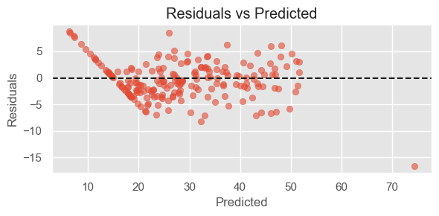
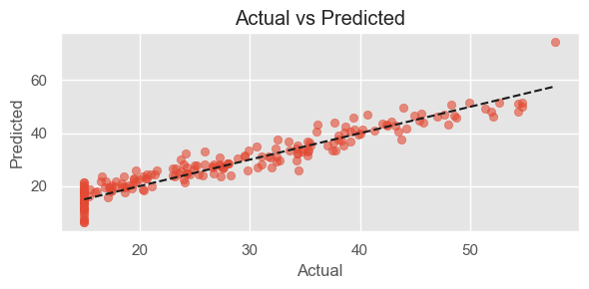
Model Evaluation & Performance Analysis
Model Evaluation - Regression Metrics
Primary Metrics: Since this is a regression task (predicting a number), R-squared and RMSE are key.
Performance on Test Set:
R-squared (R²): 0.9057 (or 90.57%)
Meaning: The model explains 90.57% of the variance in Parts_Per_Hour. This indicates a very good fit.
Root Mean Squared Error (RMSE): 3.51 parts
Meaning: On average, the model's prediction error is about 3.51 parts per hour.
Mean Squared Error (MSE): 12.30
Regularization(Lasso): R-Sqare : 0.9061

Slide 11
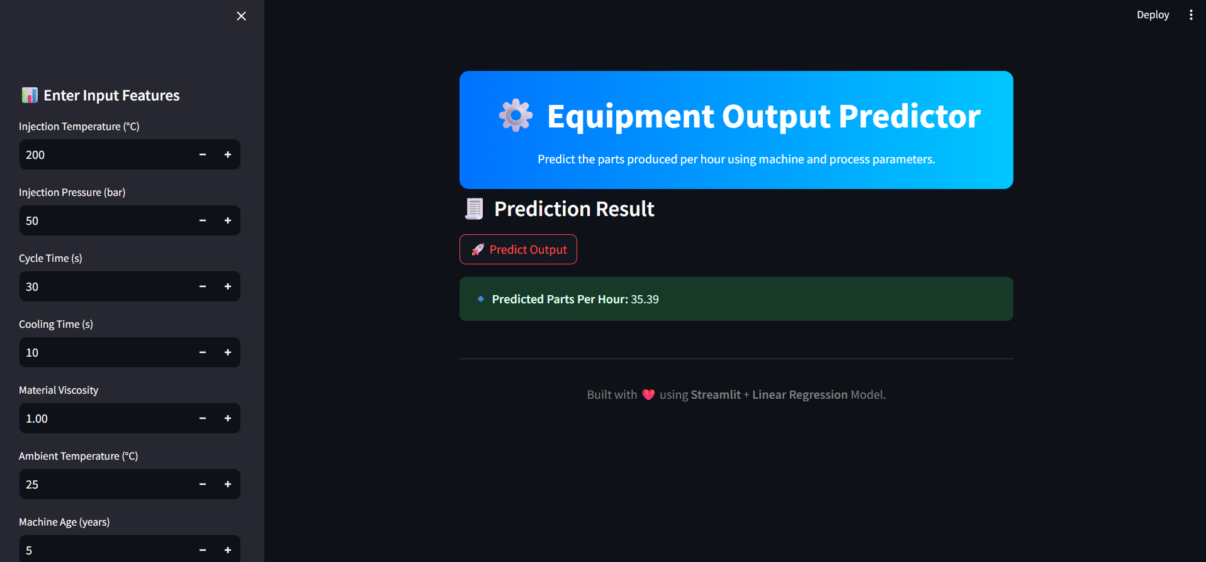
Stream API Deployment
Flask-based Inference Endpoint: A lightweight Flask API was developed to serve the trained machine learning model. It handles incoming data requests, performs preprocessing, and returns predictions in real time.
Real-time Predictions via REST API: The Flask API exposes endpoints (e.g., /predict) that can be accessed through HTTP POST requests. This allows external systems or applications to send data and instantly receive model inferences.
Deployment on Docker Container: Both the Flask backend and Streamlit frontend are containerized using Docker. The environment, dependencies, and services are encapsulated within the container, ensuring platform independence, scalability, and easy deployment on any host or cloud platform.

Slide 12
Conclusion
Successfully built and deployed a Linear Regression model for predicting manufacturing output.
Achieved an R² of 0.9061 (after Lasso fine-tuning), indicating strong predictive performance.
Identified key factors: Cycle Time, Efficiency Score, Material Grade, and Shift.
The model enables real-time production optimization and anomaly detection.
Future scope: Explore non-linear models and integrate with internal dashboards for seamless use

Slide 13
Any Queries ???

